Slide 1
INTRODUCTION TO ICT
OWOYESIGIRE URBANS MUJUNI
mujuniurbans@gmail.com
0771449642

Slide 2
KEY WORDS
Data
Information
Hardware
Software
Ict
Ict tools

Slide 3
Method of Assessment
Assessment will be in terms of tests,coursework and practical exercises (40%) and certification examination (60%) .

Slide 4
Method of Delivery:
This Course will be delivered primarily through the lecture method complemented by students’ group discussions. In addition, blended learning and case studies will be used to enhance the students' analytical and communication skills.

Slide 5
Method of Communication:
REQUIREMENTS:
Telegram
E-mail
Sms
WhatSapp
Smart Phone
Telegram App or WhatSapp
Active Email
No prior Knowledge needed
Laptop if possible

Slide 6
LESSON 1 –
COMPUTERS AND DEVICES
In this section, you will learn how to:
• Define the term ICT
• Identify different types of ICT tools and services
• Identify main types of hardware and their classifications
Identify Components of computer
Uses, Applications and categories of computers

Slide 7
Definition of ICT
Terms such as IT or ICT are commonly used in relation to the application of
technology in the modern world. “ICT” stands for Information and
Communication Technology. This is a general term for describing the use of
digital technology to access, store, and process information into an organized and
understandable form. Virtually every device or computer program that creates,
stores or uses digital information can be considered a part of an ICT system. This
ranges from your laptop or smartphone all the way up to the large networks and
infrastructures that support businesses and large organizations.

Slide 8
Types of ICT Services/Uses
ICT has radically transformed people’s lives at home, in education and at work. It has altered how people communicate, how they store and access information, how they work, and how they spend their leisure time.
In short, ICT systems allow people to better explore ideas, manage information, find answers to questions, solve problems, and become more productive.
Different types of ICT services and their uses include;

Slide 9
Con’t
Internet services
Online banking, online shopping, e-mail, and sharing documentation are
all facilitated by Internet technology.
• Mobile technology
Video conferencing
Telemedicine etc

Slide 10
APPLICATIONS AND FUNCTIONS OF COMPUTERS
Computers are applied in the areas of ;
Education
Research
Business
Health
Communication
Military/security
Home
Entertainment / leisure
Astronomy and
Transport.

Slide 11
THE COMPUTER SYSTEM/COMPONENTS OF A COMPUTER
A system is a collection of interrelated interacting components that work together to achieve a common goal.
A Computer System is a collection of the required hardware (input, output, storage, and processing) devices, Software, and Human ware required for the computer to perform as expected.
Failure of one of the system components may imply failure for the whole system. Since computing requires input, processing, storage and output, there are many items that do something specifically at each of the stages. The computer system basically consists of hardware, software,procedures, humanware, data and, communication.

Slide 12
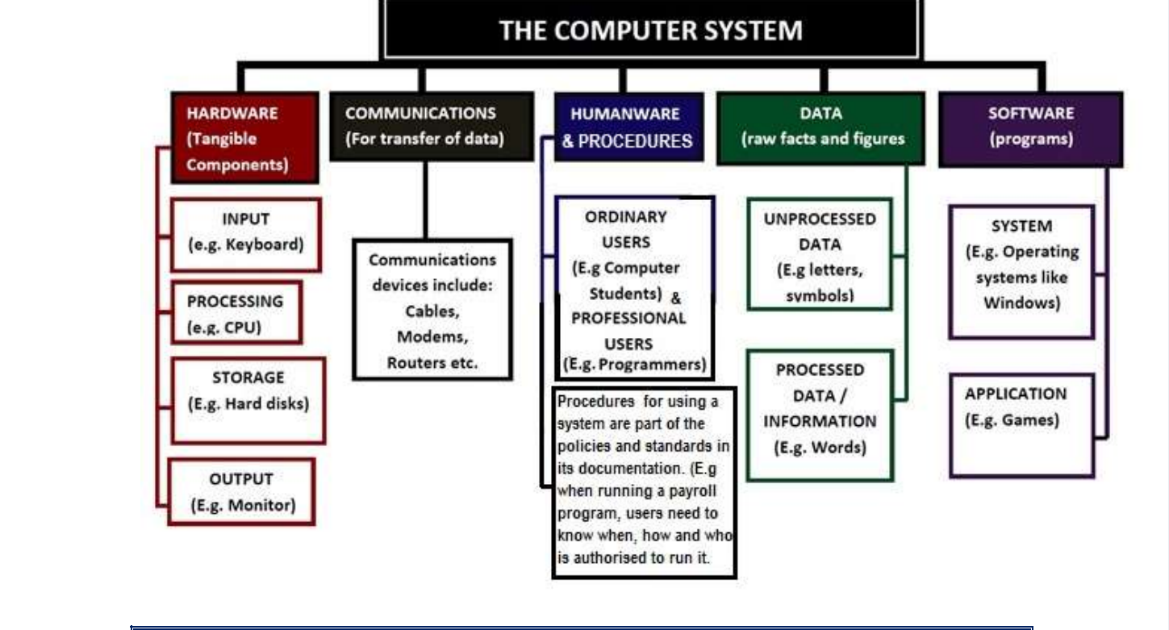

Slide 13
1. COMPUTER HARDWARE
This is a term used to describe all the various physical devices of a computer.
Computer hardware components are tangible (they can be touched).
Computer hardware includes;
Input devices like the keyboard and mouse
Processing devices like the Microprocessor Chip(CPU),
Storage devices like the Hard disks and the CDs,
Output devices like the monitor and the printer.

Slide 14
COMPUTER SOFTWARE
Software is a term for electronic instructions that tells the computer how to perform a
task. These are a series of programs (instructions) that tell the computer what and
how to work.
Computer software can be grouped into System software and Application software.
System software like the Operating system (such as Windows, Linux, UNIX, DOS, Mac
Os etc.) are used to manage and coordinate all the computer resources and activities.
Application software (such as Games, Calculator and Media Player, Word Processors,
etc.) solve the specific or exact needs of the user.

Slide 15
2.COMPUTER HUMAN WARE /USERS
This is the most important component of a computer system.
Human ware refers to the people who operate and initialize instructions to the computer system. They are the users of the computers.
They design and develop computer systems, operate the computer hardware, create the software, and establish procedures for carrying out tasks.

Slide 16
KINDS OF COMPUTER USERS
There are two kinds of Computer Users:
Ordinary user - is someone without much technical knowledge of computers but uses computers to produce for professional or personal
tasks, enhance learning, or have fun. Ordinary users include; Computer students, Typists (Secretaries), etc.
Professional user -is a person in a profession involving computers who has had formal education in the technical aspects of computers; Examples include Computer programmers, webmasters, etc

Slide 17
3.PROCEDURES
Procedures are the policies, standards and methods to be followed in using, operating, and maintaining an information system. Specifications for the use, operation and maintenance of information systems are collected in help facilities, user manuals, and similar documentation, and are commonly delivered in electronically.

Slide 18
4.COMPUTER DATA
Data refers to raw facts and figures that are processed into information.
Data is anything in a form suitable for input into a computer for processing.
Data can also be grouped into two:
Unprocessed data Like Letters, digits and symbols (e.g., a, b, c, &, ...), Musical notes, etc.
Processed data (Information) Like a words (e.g. boy), a mathematical formula, grades, a piece of music, a song etc.

Slide 19
5.COMPUTER COMMUNICATION
Computer communication is the transmission of data and information over a channel between two computers.
Computer communication allows sharing of hardware, software and transfer of data and information stored among computers in a network like Internet. It also facilitate communications between people e.g. through email. Communications devices are used for enabling computer communication. They include Cables, Switches, Routers Modems

Slide 20
ACTIVITY
Differentiate between the following terms:
(a) Hardware and Software
(b) Input and Output
(c) Data and Information
(d) Application Software and System Software
2. Give four reasons why Human ware is regarded the most important part of the computer system.

Slide 21
COMPUTER HARDWARE
Computer hardware refers to the all the tangible components of the computer system. Every time, new devices are invented and used for different purposes. Computer hardware equals the collection of physical elements that comprise a computer system. Computer hardware refers to the physical parts or components of a computer such as monitor, keyboard, hard drive disk, mouse, printers, graphic cards, sound cards, memory, motherboard and chips, etc. all of which are physical objects that you can actually touch.

Slide 22
CLASSIFICATION OF COMPUTER HARDWARE
Computer Hardware is commonly classified according to the tasks they perform. Therefore major computer hardware classifications include;
Input devices
Output devices
Storage devices
Processing devices

Slide 23
INPUT DEVICES
An input device is any hardware component that allows a user to enter data and instructions into a computer. Users use input hardware to communicate to the computer. Some of the common input hardware deices include;
A keyboard
Mouse
Touchscreen
Joysticks
Scanners and
Biometric readers.

Slide 24
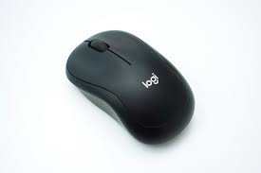
Mouse
This is a device that controls the movement of a pointer on the screen. It is an extension of your hand since you cannot touch inside the computer.
Functions of a mouse
Pointing
Clicking
Double clicking
Dragging
Scroll
Right Button
Left Button

Slide 25
Types of Mice
The three types of mice are;
Desktop Mouse: this is commonly used with desktop computers and has two push buttons on top
Track ball mouse: this is common in laptops. This type is a rolling ball that and buttons are embedded within the keyboard
Touch pad mouse: this is a small, flat, rectangular pointing device that is sensitive to pressure and motion.

Slide 26
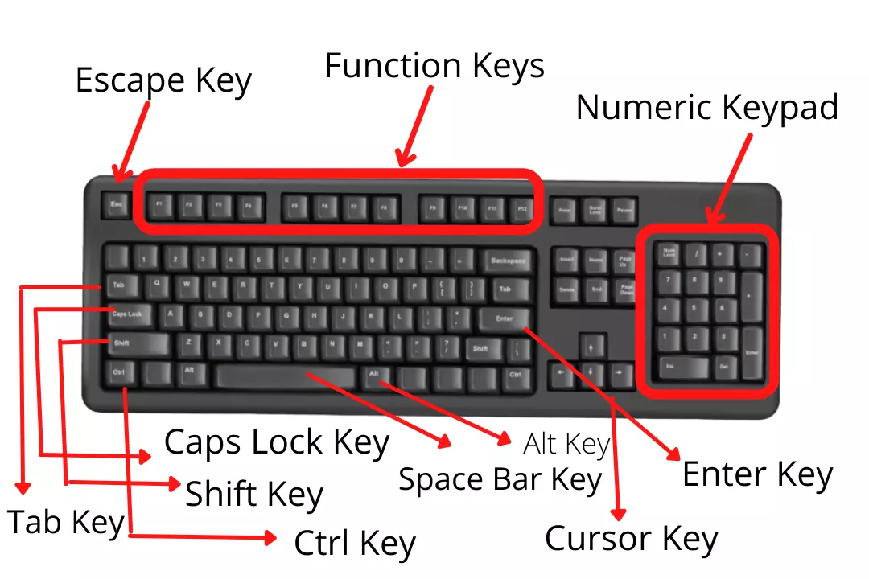
Keyboard
Most text input is done by typing a keyboard. The keyboard is the primary input and control device of a computer.

Slide 27
Keyboard parts and their Functions
A keyboard has the following major parts
Typewriter Area: This is a part that looks like or is similar to a typewriter keyboard.
Function Keys: These are labelled F1-F12 and have different functions in different programs#

Slide 28
c) Numeric Keypad: This is similar to a calculator and can be utilized as an adding machine once the Num lock is on.
d) Special Keys: on the keyboard, there are keys are not found on the typewriter keyboard. These key are ones called special keys. They include Alt, ctrl.
e) Cursor control keys: A cursor is a blinking bar on the key screen which indicates where text should be. Cursor control keys include, Home, End, Page down, Page up, Insert, End, Arrow keys which drive the cursor across the screen. They keys are also called Navigation keys

Slide 29
FUNCTIONS OF KEY BAORD BUTTONS
Space bar: it is the longest button on the keyboard and is used to create space within words in the text.
Backspace: it erases data on the left of the cursor and any highlighted data
Enter/Return Key: pressing it takes you to the new line
Delete: erases data on the right of the cursor and any highlighted data
Shift: it is held down to turn on capital letters and some sysmbols such as ?, !, >,<,@
Caps lock. This turns on capital letters and turns to small letters letters when pressed again.

Slide 30
Num lock: it makes the number pad active if pressed and if you pressed again it deactivates the number
Tab: it can be used to create space in a word document. It can also be used to move a round a group of icons
End: takes the cursor to the end of a line or when pressed together with ctr takes the cursor to the end of the text
Home: takes the cursor to the beginning of a line or when pressed with Ctrl takes the cursor to the beginning of text
Escape(ESC): Terminates process
Alternate(ALT): alternates between two things
Control(Ctrl): used in combination with other keys to produce certain results
Pege up: takes you up the page

Slide 31
Page down: takes you down a page
Print screen (prtsc): Allows you to print the all the contents of the screen
Scroll lock: allows you to control the scroll bar
pause/break: allows you to stop recursive information being displayed on the screen
Function keys: These perform specific functions depending on the programme

Slide 32
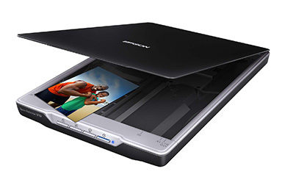
Scanners
A scanner allows you to scan printed material and convert it into a file
format which may be used within the PC. You can scan pictures and then manipulate these inside the PC using a graphics application of your choice.

Slide 33
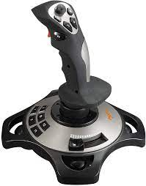
Joysticks
Many games require a joystick for the proper playing
of the game. There are many different types, the
more sophisticated respond to movement in 3 axis
directions, as well as having a number of configurable
buttons.

Slide 34
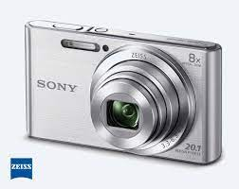
Digital Camera
A digital camera can be used in the same way a traditional camera can, but
instead of storing images on rolls of film which require developing, the
images are stored digitally in memory housed
within the camera (or on memory cards). These
pictures can easily be transferred to your
computer and then manipulated within any
graphics programs which you have installed on
your computer.

Slide 35
OUTPUT DEVICES
This is any hardware component that presents the information to the user. Output device accept information from the CPU and produce it in a suitable format. Include items such as monitors, printers, speakers and headphones.
Speakers and headphones
Most computers are sold with the capability to add a pair of speakers to your system unit. In fact, in some cases, the computer screen may have speakers built directly into the unit. Most computers allow you to plug headphones into one of the computer sockets.

Slide 36
Printers
Most data is printed once you have created it and there are a vast number
of different printers available to accomplish this. Most common are inkjet
and laser printers both of which can now produce coloured output.

Slide 37
The CPU
The CPU (Central Processing Unit) is one of the most important components within your computer. It determines how fast your computer will run and the CPU speed is measured by its MHz or GHz speed. Thus, a 2 GHz Pentium is much faster than say a 1 GHz Pentium CPU. It is the CPU which performs all the calculations within the computer, when running programs such as word-processors,
spreadsheets and databases.

Slide 38
Parts of the CPU
The CPU contains following elements:
Control Unit: The control unit is responsible for controlling the sequencing and timing of the other elements making up the CPU.
Arithmetic Logic Unit (ALU): The ALU performs the mathematical
calculations using data stored within the CPU registers.
Registers: The registers are memory storage areas within the CPU that holds the data that is worked on by the ALU.
BUS: The computer bus transports data between the memory and registers.

Slide 39
Plotter
Plotters are used to print or plot large formats such as floor plans and large photographic posters. Plotters are often used by engineers,
designers and architects to produce large technical drawings (often a metre wide and any length). The paper is rolled back and forth, while a set of ink pens move side to side, dropping down onto the paper when required.

